Slide 1


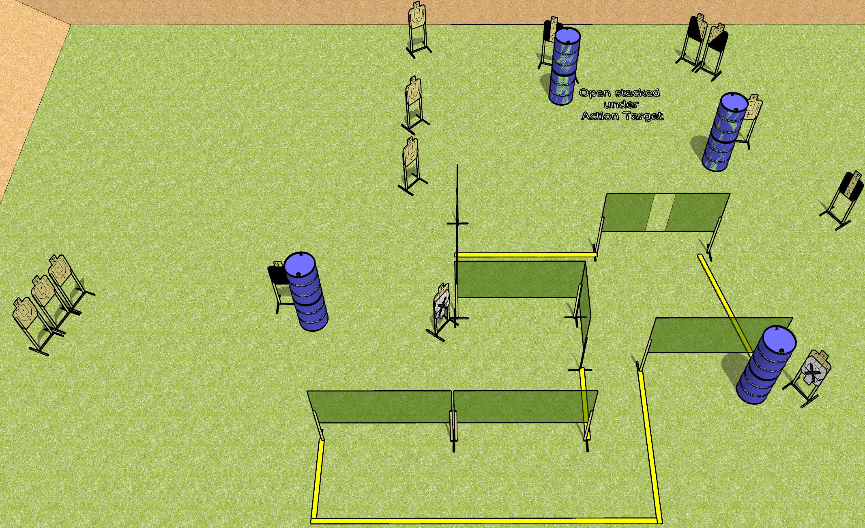
 | Dothan Gun Club – USPSA Match Break Down Course Designer : Drew Coleman
Round Count 32 rounds 16 USPSA targets
Equipment List 11 wall feet 2 medium fault lines 1 headshot, 2 tuxedos, 2 diagonal, 1 action target

Slide 2
Break Down
Written Stage Briefing
Break Down is a 32 round, 160 point, Comstock course of fire. There are 16 USPSA targets. The best 2 hits on paper will score, and steel must fall to score. The start signal is audible.
Handgun start position is anywhere outside the shooting area, wrists below belt. Handgun is loaded and holstered.
PCC start position is anywhere outside the shooting area, stock on belt. Loaded carbine is held with both hands, safety on.
On start signal, engage targets as they become available from within the shooting area.

